Slide 1
Topics (Chapter 16)
Define and use structured data types in a C program.
Program Design
Abstraction
Access the members of a struct
Write functions that take structs as parameters
Write functions that return structs
Next class:
Nested Arrays and Structures in C
Object Oriented Programming in C++

Slide 2
Program Design
Most full-featured programs are at least 100,000 lines long.
Writing large programs is quite different from writing small ones.

Slide 3
Program Design
Issues that arise when writing a large program:
Style
Documentation
Maintenance
Design
We will focus on design techniques that can make programs readable and maintainable
Abstraction (today)
Modularity (in two weeks)

Slide 4

Dog sitting camp
Imagine running a dog sitting camp, with hundreds of dogs, and you have to keep track of the names, ages, gender, breed, and number of nights for each pet.
Name: Rocky
Owner name: Joe Smith
Age: 2
Gender: Female
Breed: Golden Retriever
num_nights: 3

Slide 5
Abstraction
With hundreds of dogs, it would be inefficient to write unique code for each dog.
How would you design simple, reusable software to model the dogs?
Abstraction means only showing essential details, and purposefully hiding other details in the development of a program

Slide 6
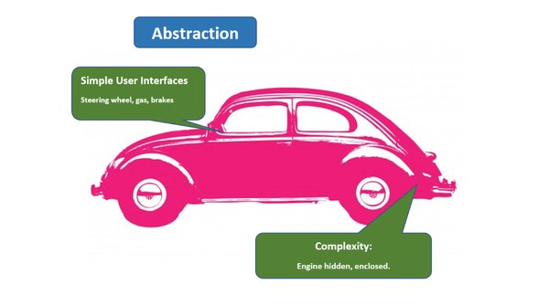
Abstraction
Hide complex details from user
Simple, high level user interfaces
Easier software maintenance
Code updates rarely change abstraction

Slide 7
Abstraction
Grouping related information together to form a structure makes the code shorter and easier to maintain.
Very important when working on your program incrementally
Prevent it from becoming entangled and complex
You can split a program into small chunks
Make teamwork possible (the section that you work on is able to function without knowledge of the inner workings of your colleague’s section)

Slide 8
Structures

Slide 9
Declaring Structure Variables
Often need to keep track of several pieces of information about a given thing.
A structure is a logical choice for storing a collection of related data items.
Suppose we need to store information about parts in a warehouse, we can create a structure that collects information about a part.

Slide 10
Defining a Structure Type
A structure tag is a name used to identify a particular kind of structure.
The declaration of a structure tag named part:
struct part {
int number;
char name[NAME_LEN+1];
int on_hand;
};
Note that a semicolon must follow the right brace.
“tag name”
10

Slide 11
Declaring a Structure Variable
The part tag can be used to declare variables:
struct part part1, part2;
We can’t drop the word struct:
part part1, part2; /*** WRONG ***/
part isn’t a type name; without the word struct, it is meaningless.
11

Slide 12
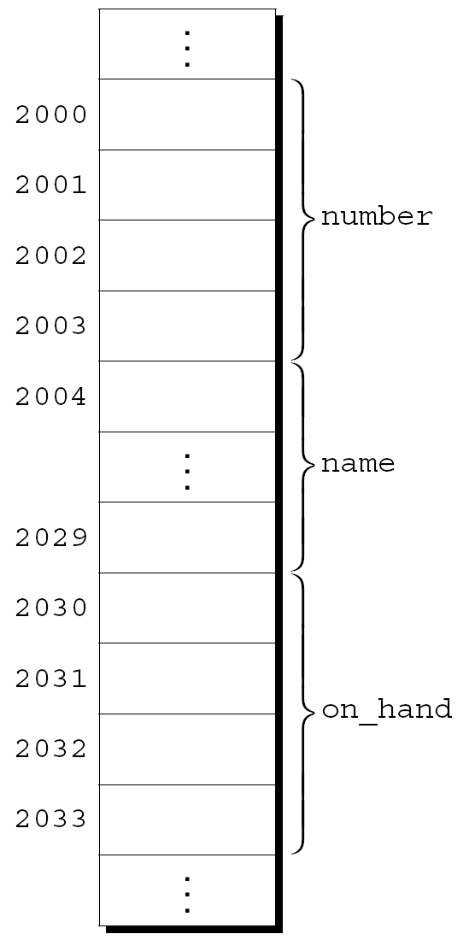
Declaring Structure Variables
The members of a structure are stored in memory in the order in which they’re declared.
Assumptions:
part1 is located at address 2000.
Integers occupy four bytes.
NAME_LEN has the value 25.
There are no gaps between the members.
12

Slide 13
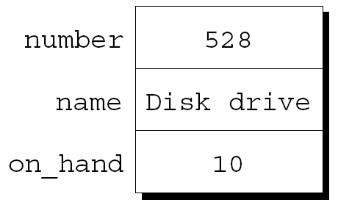
Initializing Structure Variables
A structure variable can be initialized using an initializer list:
struct part{
int number;
char name[NAME_LEN+1];
int on_hand;
};
int main(){
struct part part1 = {528, "Disk drive", 10};
struct part part2 = {914, "Printer cable", 5};
return 0;
}
13

Slide 14
Members of a struct
Members of a struct can be any previously defined type
Including arrays
Including other structs
Including pointers

Slide 15
Operations on Structures
To access a member within a structure, we use “.” operator (the dot operator).
We write the name of the structure first, then a period, then the name of the member.
part1.number
part1.name
part1.on_hand
Statements that display the values of part1’s members:
printf("Part number: %d\n", part1.number);
printf("Part name: %s\n", part1.name);
printf("Quantity on hand: %d\n", part1.on_hand);

Slide 16
Operations on Structures
The dot operator takes precedence over nearly all other operators.
Example:
scanf("%d", &part1.on_hand);
The . operator takes precedence over the & operator, so & computes the address of part1.on_hand.
16

Slide 17
Operations on Structures
The other major structure operation is assignment:
part2 = part1;
The effect of this statement is to copy part1.number into part2.number, part1.name into part2.name, and so on.
17

Slide 18
Operations on Structures
The = operator can be used only with structures of compatible types.
Structures declared using the same type name are compatible.
Other than assignment, C provides no operations on entire structures.
In particular, the == and != operators can’t be used with structures.
18

Slide 19
Exercise
Given the following struct declaration and initialization, which condition will determine if s1 and s2 contain the same values for num and str?
struct s{
int num;
char str[31];
}
struct s s1, s2;
19

Slide 20
Exercise
Which condition will determine if s1 and s2 contain the same values for num and str?
s1 == s2
s1.num == s2.num &&s1.str==s2.str
s1.num == s2.num &&strcmp(s1.str, s2.str)
s1.num == s2.num &&strcmp(s1.str, s2.str)==0
20

Slide 21
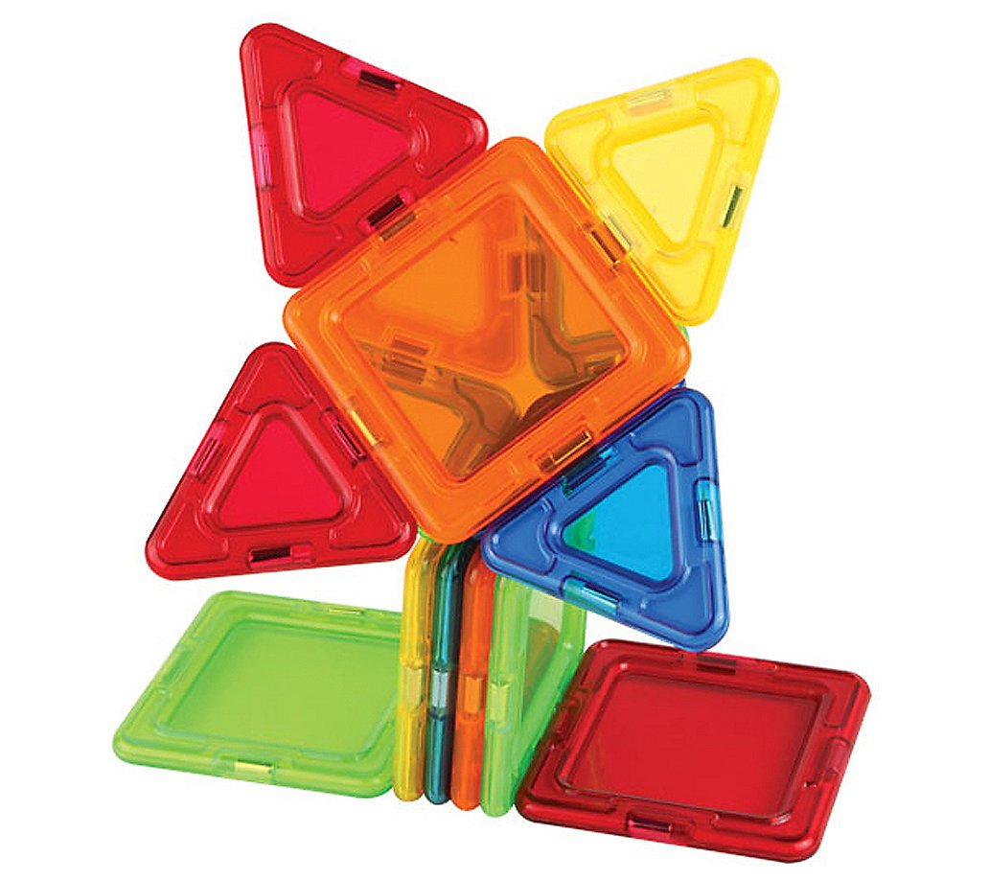
Example Program
Declare a structure for magformer
In the main function, declare and initialize variables of magformer

Slide 22
Structures as Function Arguments and Return Values
Functions may have structures as arguments and return values.
Passing a structure to a function and returning a structure from a function both make a copy of all members in the structure.

Slide 23
Structures as Arguments and Return Values
A function with a structure argument:
void print_part(struct part p)
{
printf("Part number: %d\n", p.number);
printf("Part name: %s\n", p.name);
printf("Quantity on hand: %d\n", p.on_hand);
}
A call of print_part:
print_part(part1);

Slide 24
Structures as Arguments and Return Values
A function that returns a part structure:
struct part build_part(int number,
char *name,
int on_hand)
{
struct part p;
p.number = number;
strcpy(p.name, name);
p.on_hand = on_hand;
return p;
}
A call of build_part:
part1 = build_part(528, "Disk drive", 10);
24

Slide 25
Example Program
In the magformer program, define a compare function that compares if the shape and color of two magformers are the same.

Slide 26
Programming Exercise, part I
Suppose we wish to store information about colors defined by three pieces of data: red(an int), green (an int), and blue (an int). Each piece is an integer in the range of 0 to 255.
Write a program that declares a struct named color.
The main function:
int main(){
return 0;
}

Slide 27
Programming Exercise, Part II
In main function, declare a variable magenta of type struct color with the initial values: 255, 0, 255. Display the values of megenta’s members using the “.” Operators.
In main function, declare a struct color variable color2.
Read in color2‘s three members using scanf.
Display the values of color2’s members using the “.” Operators.

Slide 28
Programming Exercise, Part III
Add the following functions to the program
1.
struct color make_color(int red, int green, int blue);
Returns a color structure containing the specified red, green, and blue values. If any argument is less than zero, the corresponding member will contain zero instead. If any argument is greater than 255, the corresponding member will contain 255.

Slide 29
Programming Exercise, Part III, cont’d
2.
struct color brighter(struct color c);
Returns a color structure that represents a brighter version of the color c: each member has been divided by 0.7. If a member is 0, it is replaced by 3 before the division by 0.7. If dividing by 0.7 causes a member to exceed 255, it is reduced to 255.

Slide 30
Programming Exercise, Part III, cont’d
Test the two functions by adding the following statements in main:
struct color gold = make_color (255, 215, 0);
struct color brighter_gold = brighter (gold);
Then add statements in main to display the values of the members for brighter_gold.

